Slide 1
SUVETHA C Nm Id : au962821104097
Final Project

Slide 2
SENTIMENT ANALYSIS IN NEURAL NETWORKS

Slide 3
Introduction to Sentiment Analysis
1. Sentiment analysis, also known as opinion mining, is the process of determining the sentiment expressed in a piece of text.
2. It involves classifying the sentiment of text as positive, negative, or neutral, to understand the opinions, emotions, and attitudes conveyed by the author.
3. Neural networks, particularly Recurrent Neural Networks (RNNs) and Long Short-Term Memory networks (LSTMs), have shown promising results in sentiment analysis tasks.
4. Training a sentiment analysis model requires a labeled dataset of text samples with corresponding sentiment labels, which is used to learn the patterns and associations between words and sentiments.

Slide 4
Recurrent Neural Networks (RNNs) for Sentiment Analysis
1. RNNs are a type of neural network architecture designed for processing sequential data, making them well-suited for tasks like sentiment analysis.
2. They have the ability to capture temporal dependencies in text by maintaining an internal state or memory, which allows them to consider the context of words in sentences.
3. However, traditional RNNs suffer from the vanishing gradient problem, which limits their ability to capture long-range dependencies in text.
4. LSTMs, a variant of RNNs, address this issue by introducing gated units that control the flow of information, enabling them to better capture long-term dependencies.

Slide 5
Convolutional Neural Networks (CNNs) for Sentiment Analysis
1. CNNs, primarily used for image processing, have also been applied to text-based tasks like sentiment analysis.
2. In text classification tasks, CNNs treat text as one-dimensional signals and apply convolutional filters to capture local patterns and features.
3. By employing multiple convolutional layers followed by max-pooling operations, CNNs can effectively learn hierarchical representations of text, capturing both low-level and high-level features.
4. Pretrained word embeddings, such as Word2Vec or GloVe, are often used as input to CNNs, enabling them to leverage semantic information and improve performance.

Slide 6
Training and Evaluation of Sentiment Analysis Models
1. The training of sentiment analysis models involves optimizing their parameters using labeled datasets through techniques like stochastic gradient descent and backpropagation.
2. Common evaluation metrics for sentiment analysis include accuracy, precision, recall, and F1 score, which assess the model's ability to correctly classify sentiments.
3. Cross-validation techniques, such as k-fold validation, are often used to assess the generalization performance of the model on unseen data.
4. Additionally, techniques like hyperparameter tuning and regularization are employed to optimize model performance and prevent overfitting.

Slide 7
Challenges in Sentiment Analysis
1. Sentiment analysis faces challenges such as sarcasm, irony, and ambiguity in language, which can lead to misinterpretation of sentiment.
2. Sentiment lexicons and dictionaries may not capture the nuanced meanings of words in different contexts, affecting the accuracy of sentiment classification.
3. Domain-specific sentiment analysis requires models to be trained on domain-specific data, as sentiments expressed in different domains may vary.
4. Handling sentiment polarity shifts, where the sentiment expressed towards a topic changes over time or due to external factors, poses a significant challenge for sentiment analysis systems.

Slide 8
Application Areas of Sentiment Analysis
1. Sentiment analysis has diverse applications across various industries, including social media monitoring, customer feedback analysis, and brand reputation management.
2. In social media monitoring, sentiment analysis is used to analyze public opinion, detect trends, and identify influential users or topics.
3. Customer feedback analysis involves extracting insights from reviews, comments, and surveys to understand customer satisfaction and improve product/service quality.
4. Brand reputation management utilizes sentiment analysis to monitor online sentiment towards a brand, mitigate negative publicity, and enhance brand perception.

Slide 9
Ethical Considerations in Sentiment Analysis
1. Sentiment analysis systems should be developed and deployed with careful consideration of ethical implications, including privacy, bias, and fairness.
2. Privacy concerns arise from the collection and analysis of personal data, requiring transparent data handling practices and user consent mechanisms.
3. Bias in sentiment analysis models can lead to discriminatory outcomes, particularly against minority groups, underscoring the importance of diverse and representative training data.
4. Ensuring fairness and accountability in sentiment analysis systems involves ongoing monitoring, auditing, and mitigation of biases and unintended consequences.

Slide 10
Future Trends in Sentiment Analysis
1. Future advancements in sentiment analysis are expected to focus on improving model interpretability, context-awareness, and cross-lingual sentiment analysis.
2. Interpretable models enable users to understand how predictions are made, fostering trust and accountability in sentiment analysis systems.
3. Context-aware sentiment analysis considers the broader context of text, such as user demographics, temporal factors, and cultural nuances, to enhance accuracy and relevance.
4. Cross-lingual sentiment analysis aims to extend sentiment analysis capabilities to multiple languages, enabling sentiment understanding and aggregation across diverse linguistic contexts.

Slide 11
Conclusion
1. Sentiment analysis using neural networks has emerged as a powerful tool for understanding and analyzing textual data, with applications spanning various industries and domains.
2. Despite challenges such as bias and privacy concerns, ongoing research and advancements in deep learning techniques are paving the way for more accurate, robust, and ethical sentiment analysis systems.
3. The integration of sentiment analysis into decision-making processes, marketing strategies, and policy formulation underscores its significance in shaping public opinion and driving actionable insights.

Slide 12
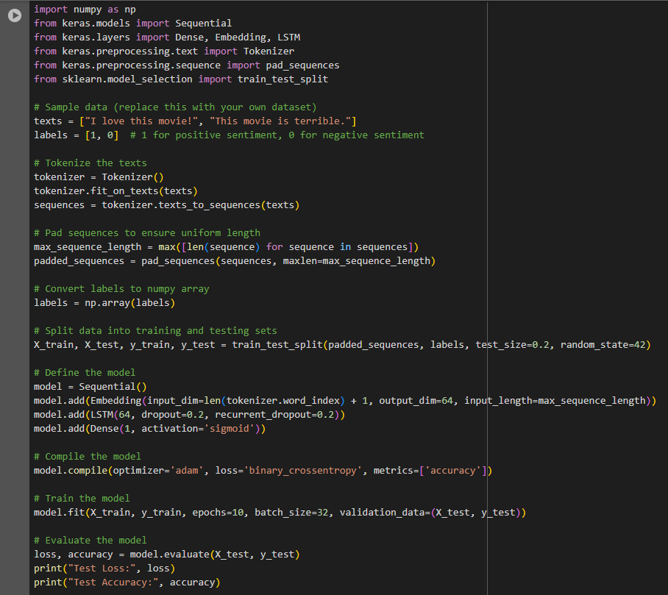
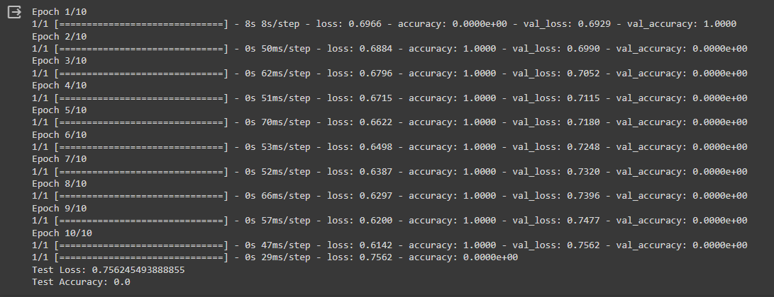
Result

